Slide 1

Heart Attack Detection Data Analysis
Ruth LD, Pasmina Sangani, Maria Gribbon
and
Hulya Nohut

Slide 2
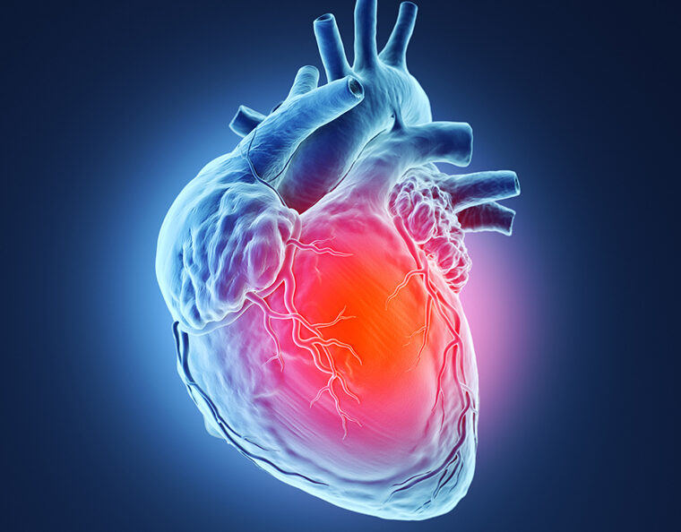
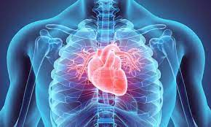
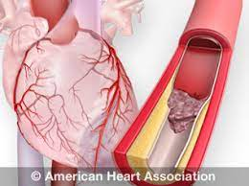
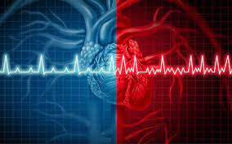
Meet the Team
MPHR - We got “Maxium Predicted Heart Rate “ Covered.
Maria Gribbon
Pasmina Sangani
Hulya Nohut
Ruth LD

Slide 3
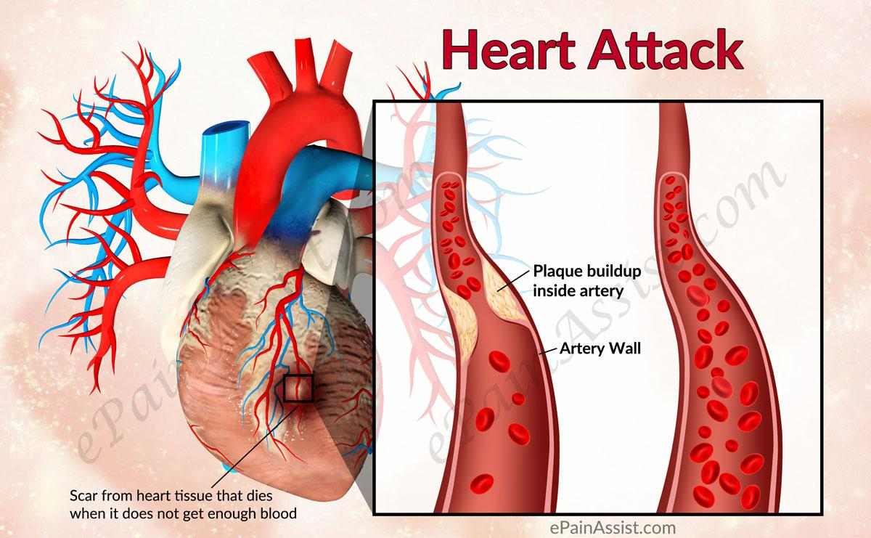
Topic
Heart-attack Detection Analysis

Slide 4
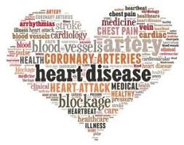
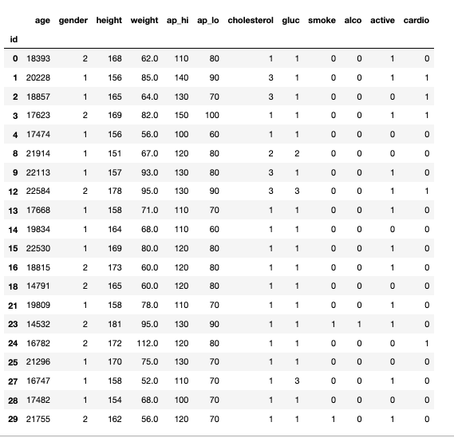
Reason why topic was chosen
Appealing dataset composition
Shows Machine Learning potential

Slide 5
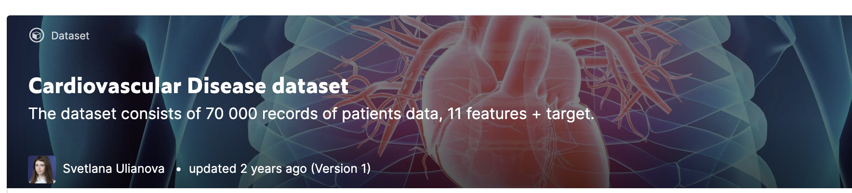
Description of Data Source
Heart-attack Detection analysis data was downloaded from Kaggle.com
Link to raw dataset: https://www.kaggle.com/sulianova/cardiovascular-disease-dataset/

Slide 6

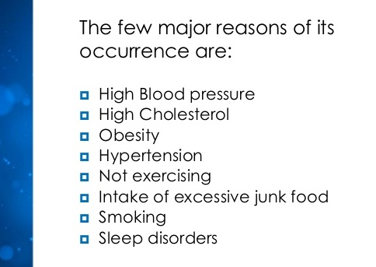
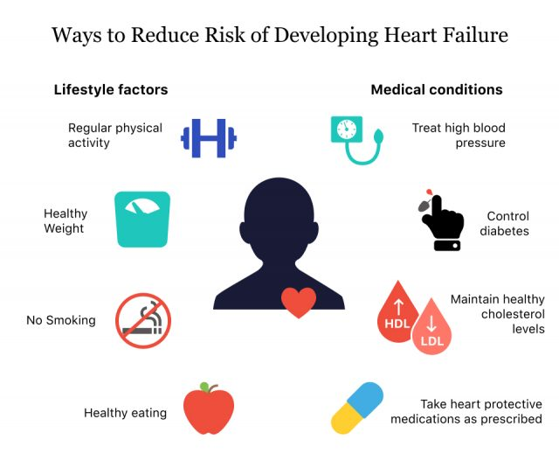
Question at hand

Slide 7
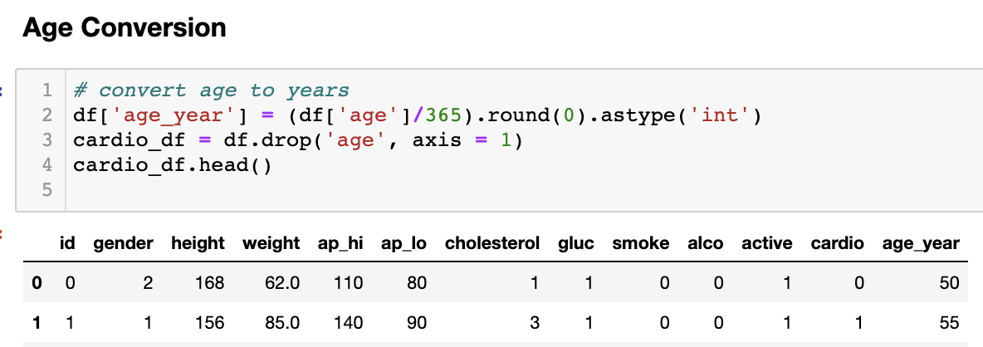
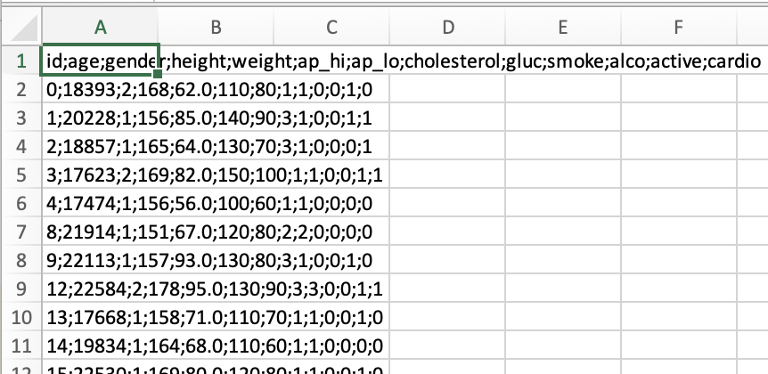
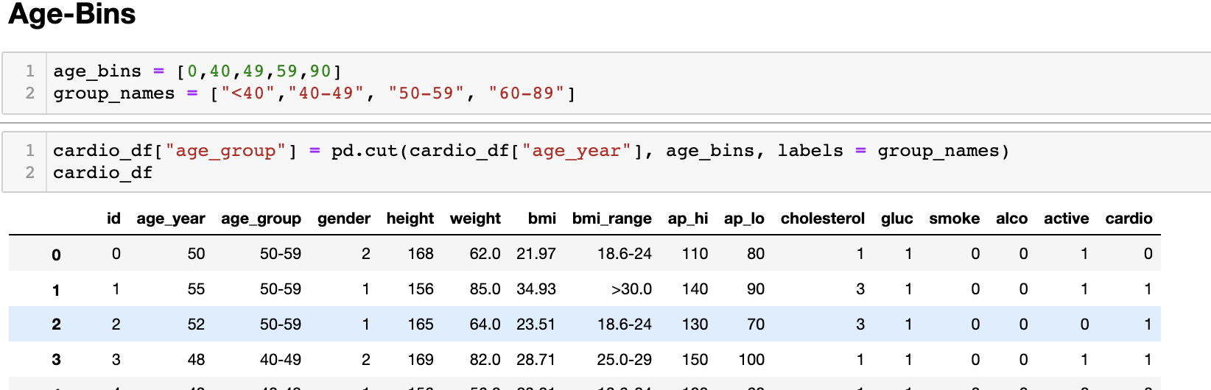
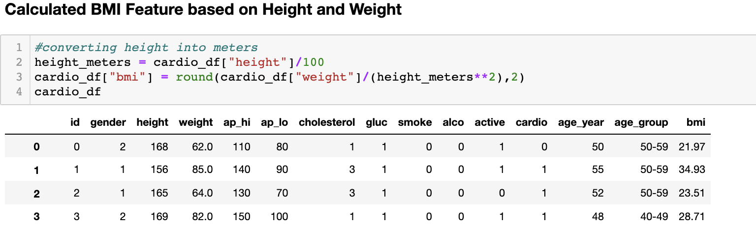
Description of data exploration
Excel for initial dive into dataset
Python for data cleanup/dataframe creation

Slide 8





Technologies Utilized
Github
Python
Jupyter Notebook
Google Docs
Excel
PostgreSQL
PGadmin
Python / Machine Learning
HTML, CSS
Tableau
AWS

Slide 9
Dataset / Database
PostgreSQL / pgAdmin
Hosted on AWS
Data started with 12+ columns
Normalized the data
Biggest challenge with query:

Slide 10
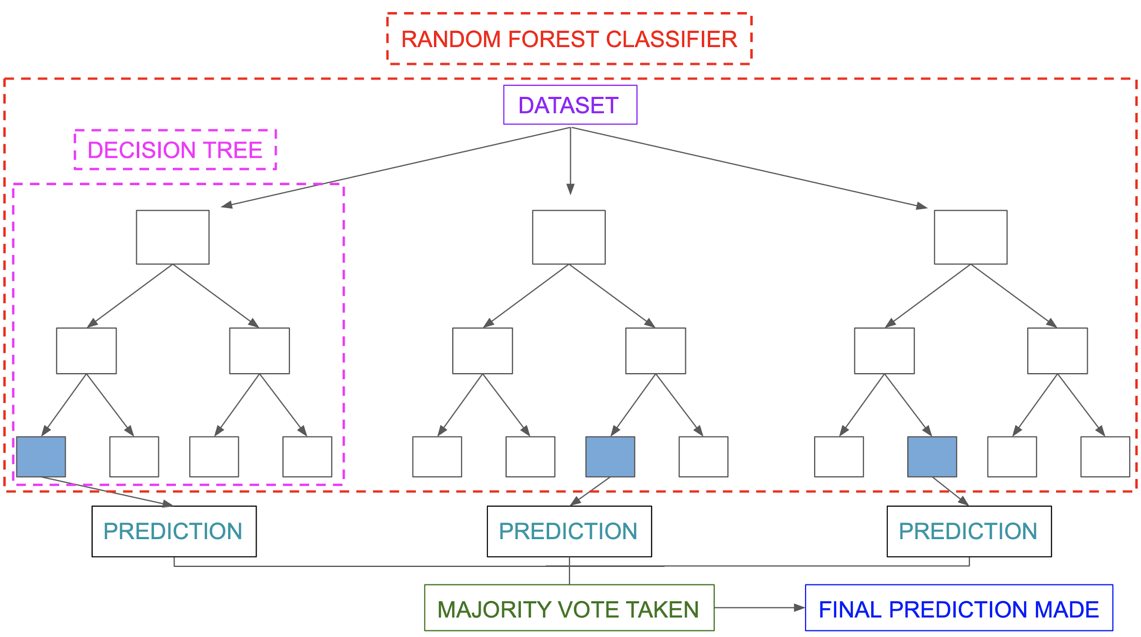
Machine Learning Model
Learning Algorithm: Random Tree
Train-Test ratio split 80/20
71% Accuracy
Benefits/Limitations

Slide 11
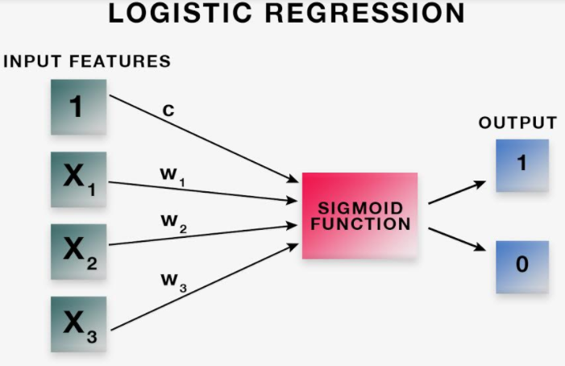
Machine Learning Model
Logistic Regression Model
Train-Test ratio split 75/25
70.67% Accuracy
Benefits/Limitations

Slide 12
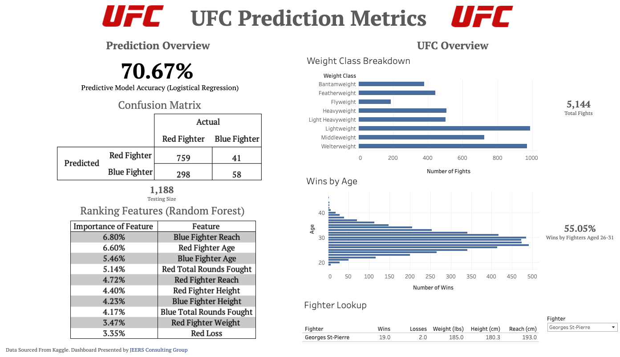
https://public.tableau.com/profile/riley4086#!/vizhome/UFC_Dashboards/UFCPredictionMetrics?publish=yes
Notes:
Goal of Dashboard to show aspects of dataset while conveying the results of our model

Slide 13
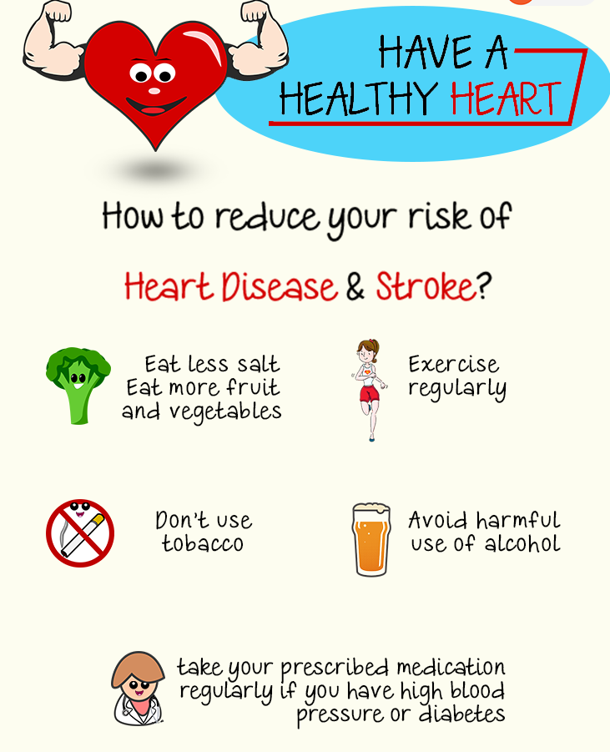
Questions?

Slide 14
Skills & expertise
Motion design
User experience
Physical Computing
HTML, CSS,JS

Slide 15
Acme Design Award recipient
Parker Music campaign

Slide 17





Slide 18

Contact
Your Name
no_reply@example.com
www.example.com

